Slide 1
The World Trade Organization
Alan V. Deardorff
University of Michigan
For presentation at Adult Learning Institute
Oakland Community College
September 25, 2018

Slide 2
Outline
History
The Institution Today
Early Issues
Current Issues
Trump and the WTO

Slide 3
World Trade Organization: History
1930s:
Tariffs raised, to high levels
1930 US Smoot-Hawley Tariff Act
Raised tariffs on 890 items
Prompted retaliation by other countries, who then also raised tariffs
Notes:
Source: Economist, “The battle of Smoot-Hawley,” December 18, 2008.

Slide 4
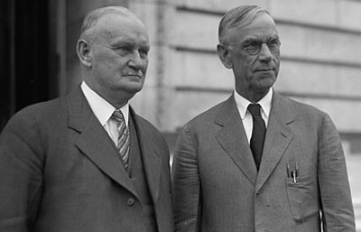
Hawley
Smoot

Slide 5
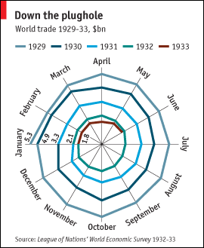
Source: Economist, “The battle of Smoot-Hawley,” December 18, 2008.

Slide 6
World Trade Organization: History
Mid-1940s:
Created IMF and World Bank at meeting in Bretton Woods, New Hampshire
US tried to create ITO = International Trade Organization
Interim agreement: GATT = General Agreement on Tariffs and Trade
When ITO failed to be approved (by US!), GATT governed trade policy by default

Slide 7
World Trade Organization: History
What GATT Does
(GATT is still the largest part of WTO)
Rules for trade policy
Forum for negotiation
Of both trade policies (e.g., tariffs) and rules
Major negotiations took place in “Negotiating Rounds”
Decisions made at occasional meetings of trade ministers: “Ministerial Meetings”

Slide 8
World Trade Organization: Rounds
Rounds of GATT Multilateral Trade Negotiations
No. | Years | Name | Accomplishments
1-5 | 1947-61 |  | Reduced tariffs
6 | 1964-67 | Kennedy | Tariffs + anti-dumping
7 | 1973-79 | Tokyo | Tariffs + NTBs
8 | 1986-94 | Uruguay | Tariffs, NTBs, Services, Intellectual Property, Textiles, Ag., Dispute Settlement, Created WTO
9 | 2001-15 | Doha | FAILED: Doha Development Agenda

Slide 9
How negotiations took place
Tariffs:
In early rounds, tariff cuts were negotiated between “principal supplier” country and “principal demander” country
Cuts are extended to all other members (MFN)
But large countries dominate this process
In recent rounds, negotiations start with a formula for tariff cuts, then negotiate exceptions

Slide 10
How negotiations took place
Rules:
Groups of countries draft changes, then persuade others
Again, large countries dominate

Slide 11
Do small and poor countries lose?
They need not lose, if they participate in the process
They benefit from the “rule of law”: Otherwise the large countries would be even more powerful
By grouping together, small countries can also exert bargaining power
They may well lose if they do not participate: growth of trade may exclude them
Tariffs did not fall on their major exports

Slide 12
Outline
History
The Institution Today
Early Issues
Current Issues
Trump and the WTO

Slide 13
World Trade Organization: Today
WTO Today
Established Jan 1, 1995
Members: 164
Most recent: Afghanistan 2016
Including:
China (as of 2001)
Russia (as of 2012)
Not including: Iran, Iraq, N. Korea
Headquarters: Geneva, Switzerland
(also home of ILO, WIPO, and others)

Slide 14
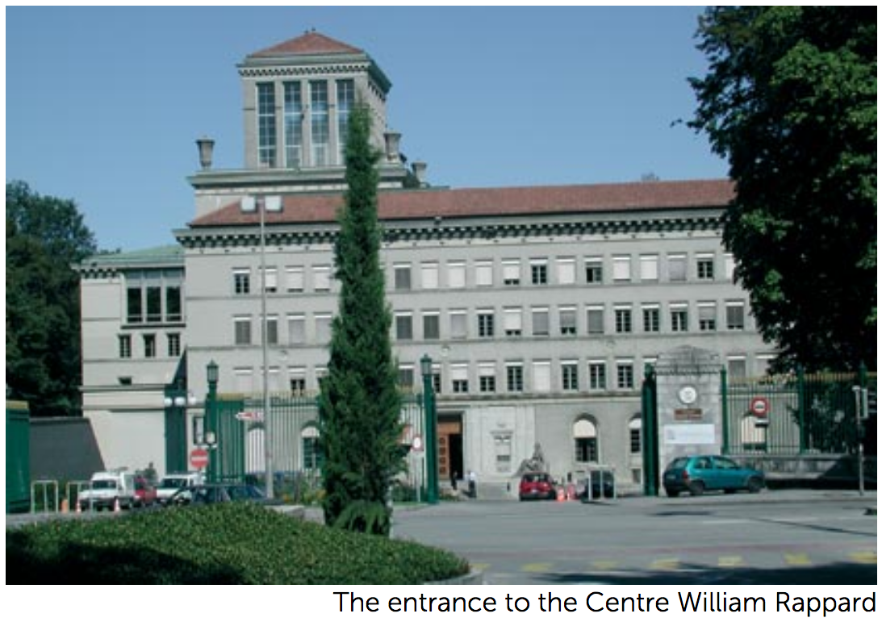

Slide 15
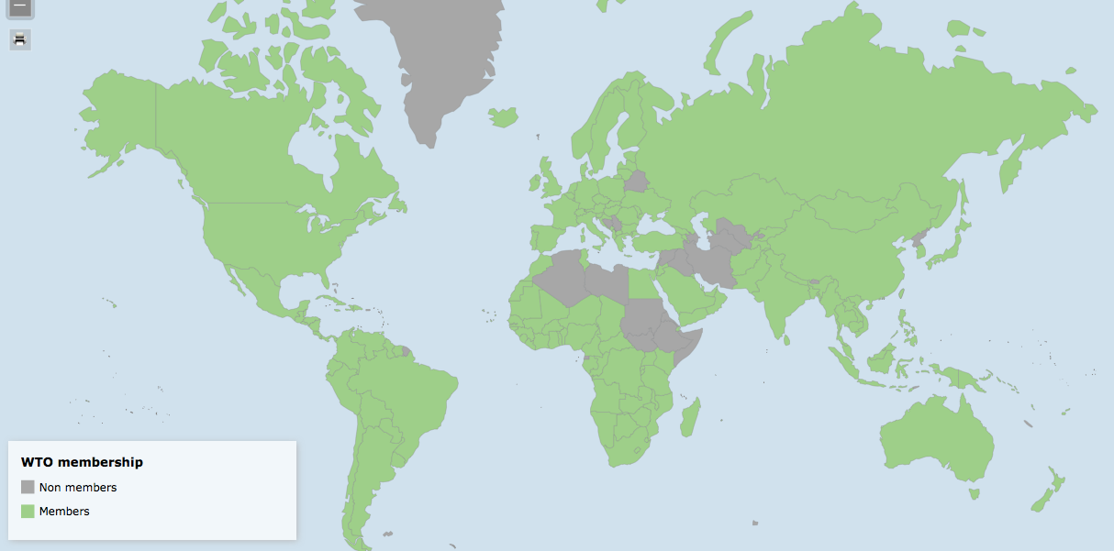
Interactive: https://www.wto.org/english/res_e/statis_e/statis_maps_e.htm

Slide 16
World Trade Organization: Today
WTO’s Three Parts
GATT (Still exists, as largest part of WTO)
GATS = General Agreement on Trade in Services
TRIPs Agreement = Trade Related aspects of Intellectual Property Rights

Slide 17
World Trade Organization: Today
WTO’s Two Basic Principles
MFN = Most Favored Nation
Each member country should treat all members as well as it treats its “most favored nation” (i.e., the member that it treats the best)
National Treatment
Once a product or seller has entered a country, it should be treated the same as products or sellers that originated inside that country
(There are many permitted exceptions to both of these principles)

Slide 18
World Trade Organization: Today
WTO Decision Making
Decisions by consensus: all countries present at ministerial meetings must agree,
In practice, large and rich countries dominate this process
They first agree among themselves
Then seek consensus based on that
Is this “democratic”?
Yes: Every country has one vote
No: Rich countries dominate decisions in practice

Slide 19
WTO Functions
Functional Outline of the World Trade Organization
Communication
Constraints
Exceptions
Dispute Settlement

Slide 20
WTO Functions
Communication | Ministerials
 | Negotiating Rounds
 | Working Groups
 | Trade Policy Review Mechanism
 | Councils and Committees
Trade Ministers (USTR, etc.) Meet Every Two Years
Tariff Reductions; Changes in Rules

Slide 21
WTO Functions
National Treatment for Service Firms (only in some industries)
Constraints | Tariff Bindings
 | Customs Valuation
 | Product Regulations
 | Quantitative Restrictions
 | Subsidies
 | Foreign Direct Investment (TRIMS)
 | Services (GATS)
 | Intellectual Property (TRIPs)
Countries negotiate and commit to maximum tariffs
Enforce Patents, Copyrights, Trademarks

Slide 22
WTO Functions
Most commonly used
Exceptions | Anti-Dumping
 | Countervailing Duties
 | Safeguards
 | Balance of Payments Protection
 | Preferential Trade Agreements
Permitted; not required
Allows NAFTA, EU, etc.

Slide 23
WTO Functions
Standing Committee that reviews most cases
Dispute Settlement | Consultation
 | Panel Recommendation
 | Appellate Body
 | Remedy | Implementation
 |  | Compensation
 |  | Retaliation
3-person Panel Decides Case
The Ultimate Remedy: Permit Tariffs

Slide 24
Outline
History
The Institution Today
Early Issues
Current Issues
Trump and the WTO

Slide 25
WTO Early Issues
Seattle Protest and Beyond
Seattle Ministerial – December 1999
Intended to start a new Round
Protesters flocked to Seattle, with objections

Slide 26
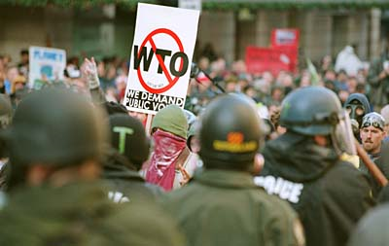

Slide 27
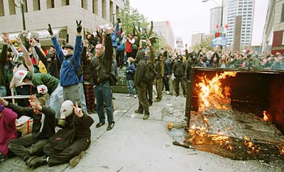

Slide 28
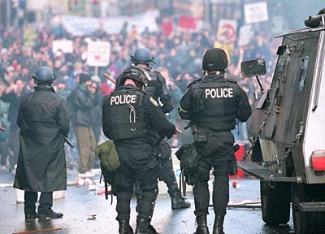

Slide 29
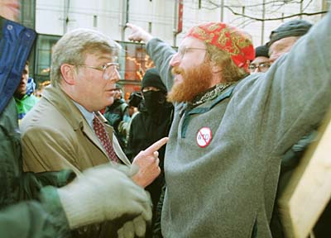

Slide 30
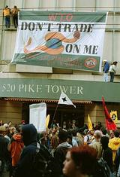

Slide 31
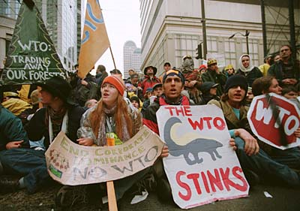

Slide 32
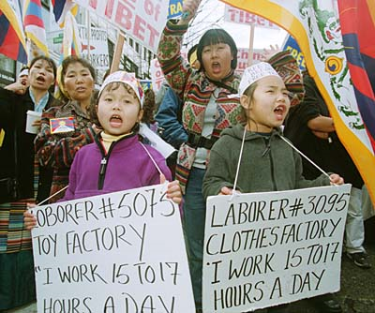

Slide 33
WTO Early Issues
Seattle Protest and Beyond
Seattle Ministerial – December 1999
Intended to start a new Round
Protesters flocked to Seattle, with objections
Labor issues
Environmental issues
Corporate dominance
Lack of transparency, democracy

Slide 34
WTO Early Issues
Seattle Protest and Beyond
Seattle Ministerial – December 1999
Negotiators failed to reach agreement
Labor standards
US & EU wanted them in trade agreement
Developing countries feared protectionism
Many other issues were also divisive
Result: Negotiating round was not begun
Protesters began showing up at other meetings as well, of IMF, World Bank, etc.

Slide 35
WTO Early Issues
Doha Round
Began at WTO Ministerial at Doha, Qatar, Fall 2001 (after Sep 11)
Emphasis on development:
“Doha Development Agenda”

Slide 36
WTO Early Issues
Doha Round
Issues to be included
US and EU agricultural subsidies and tariffs
Developing-country tariffs on manufactures
Market access for services into developing countries

Slide 37
WTO Early Issues
Doha Round
Cancún Ministerial Sep 2003
Intent was to agree on outline of agreement
Developing countries spoke as a group (for the first time)
Pushed hard for elimination of US and EU agricultural subsidies
Resisted cutting their own tariffs
Meeting ended without agreement: Failure!

Slide 38
WTO Early Issues
Doha Round
2003-5
Developing countries continued negotiating as “Group of 20”
Major countries in G20: Brazil, India, China, South Africa
Membership varies; currently 23 countries

Slide 39
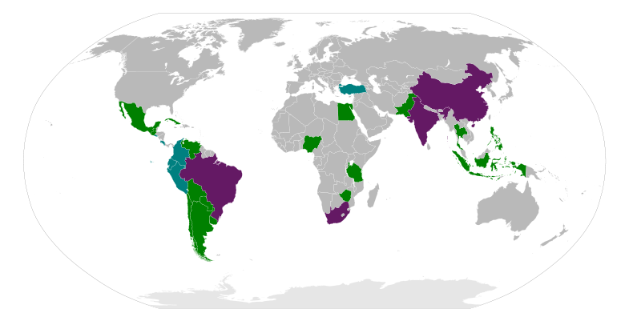
G20 of Developing Countries:
Notes:
Source: http://en.wikipedia.org/wiki/File:G20_developing_nations_map.svg

Slide 40
WTO Early Issues
Doha Round
2003-5
Developing countries continued negotiating as “Group of 20”
Major countries in G20: Brazil, India, China, South Africa
Membership varies; currently 23 countries
Developed countries gave up pushing for some Issues
In July 2004, negotiators achieved the framework agreement that had eluded them at Cancún

Slide 41
WTO Early Issues
Doha Round
Hong Kong Ministerial, Dec 2005
Negotiators were determined not to fail again
Meeting ended with “agreement,” but progress was very minimal

Slide 42
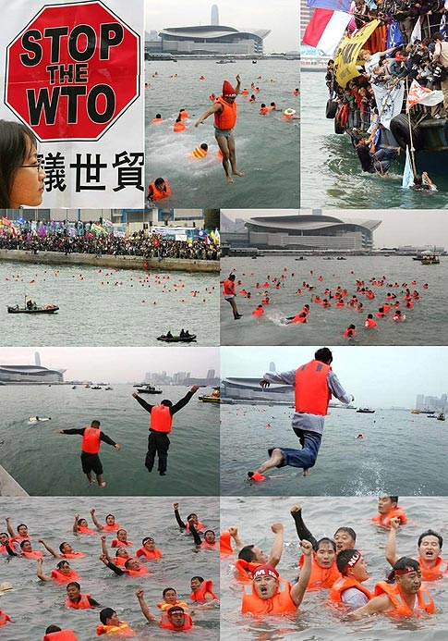

Slide 43
WTO Early Issues
Doha Round
July 2006: Doha Round Talks Suspended
June 2007: Potsdam Meeting of G-4 (US, EU, Brazil, India) failed
July 2008: Negotiations broke down over agriculture
December 2015: Nairobi Ministerial meeting
Ended without reaffirming intent to complete the Doha Round
Implicitly, that was admission that it had ended in failure

Slide 44
Outline
History
The Institution Today
Early Issues
Current Issues
Trump and the WTO

Slide 45
WTO Current Issues
What happens without Doha?
Tariffs may rise because bound tariffs won’t fall
Bound tariffs are almost twice as high as applied ones
Some argue that world trade will fall
Has it happened?
Trade did stop growing for a while, but has resumed recently
Not clear that tariffs have risen

Slide 46
WTO Current Issues
Other negotiations have been more successful
December 2013: Bali Ministerial salvaged a limited agreement, mainly on Trade Facilitation
July 2014: Implementation of the “Bali Package” was delayed by objections from the new India Prime Minister Modi
November 2014: Modi and Obama met and resolved the disagreement. Bali Package was adopted at WTO.
December 2015: Nairobi Ministerial agreed on several commitments, including to
Abolish export subsidies on farm exports.
December 2017: Buenos Aries Ministerial met but accomplished essentially nothing
Was more about friction between US (Trump) & others

Slide 47
WTO Current Issues
WTO has also succeeded in negotiating “plurilateral agreements”
These are agreements the members can sign or not, and are only binding on those who do
Agreements that have been negotiated:
Information Technology Agreement (with an update currently being negotiated)
Financial Services Agreement
Basic Telecommunication Services Agreement
Anti-Counterfeiting Trade Agreement

Slide 48
WTO Current Issues
WTO Disputes
There have been 566 disputes brought to the WTO since its creation in 1995 (as of 9/25/18)
Two of the more notable were
EU ban on hormone treated beef (ruled by WTO to have no scientific basis)
US shrimp-turtle import prohibition (struck down by WTO)

Slide 49
WTO Current Issues
WTO Disputes
More
Boeing-Airbus dispute over subsidies by EU and US (WTO ruled that both were using illegal subsidies)
Canada and Mexico complaint about US Country-of-Origin Labeling (COOL) law for meats (WTO ruled against US law)

Slide 50
WTO Current Issues
Other WTO Issues
Independence
US (under Obama) vetoed reappointment of a member of the Appellate Body
He had found against the US in several cases
Others worry that this will undermine the body’s independence
This makes US look like a bully
Since then, US under Trump has blocked further appointments
The Appellate Body may soon lack a quorum to make decisions.

Slide 51
WTO Current Issues
Other WTO Issues
China’s “market economy status”
Because China is currently classed as a non-market economy, its prices need not be used in deciding anti-dumping cases
This leaves others free to base dumping decisions on prices in other countries, hurting China
China is arguing for market economy status, and the issue is likely to be addressed soon by the Appellate Body

Slide 52
Outline
History
The Institution Today
Early Issues
Current Issues
Trump and the WTO

Slide 53
Trump and the WTO
Oct 25, 2017, on Fox interview with Lou Dobbs:
“The WTO, World Trade Organization, was set up for the benefit for everybody but us.”
“we lose the lawsuits, almost all of the lawsuits … within the WTO”
In fact, like other countries, US
Wins most of the cases it brings
Loses most the cases brought against it
Since 1995, in all cases complainant has won 90%
As complainant, US has won 91%
As respondent, US has lost 89%
Notes:
https://www.factcheck.org/2017/10/trump-wrong-wto-record/

Slide 54
Trump and the WTO
Oct 30, 2018, FT:
Donald Trump threatens to pull US out of the WTO
“If they don’t shape up, I would withdraw from the WTO,” Mr Trump said in an interview.

Slide 55
Trump and the WTO
WTO Disputes since Jan 20, 2017:
By United States
Date | Against | Regarding
Sep 2017 | Canada | Wine
Mar 2018 | India | Export measures
Mar 2018 | China | Intellectual Property
Jul 2018 | Canada | Additional duties
Jul 2018 | China | Additional duties
Jul 2018 | EU | Additional duties
Jul 2018 | Mexico | Additional duties
Jul 2018 | Turkey | Additional duties
Aug 2018 | Russia | Additional duties
US complaints about others’ retaliation against US tariffs on steel and aluminum

Slide 56
Trump and the WTO
WTO Disputes since Jan 20, 2017:
Against United States
Date | By | Regarding
Mar 2017 | Turkey | CVDs on pipes & tubes
Nov 2017 | Canada | 2 on Softwood lumber
Dec 2017 | Canada | Trade remedies
Jan 2018 | Viet Nam | Anti-dumping on fish fillets
Feb 2018 | Korea | AD& CVDs
Feb 2018 | Viet Nam | Pangasius seafood products
Apr 2018 | China | 2 on Tariffs
May 2018 | Korea | 2 on tariffs, washers & solar panels

Slide 57
Trump and the WTO
WTO Disputes since Jan 20, 2017:
Against United States
Date | By | Regarding
May 2018 | India | Tariffs on steel & aluminum
Jun 2018 | EU | Tariffs on steel & aluminum
Jun 2018 | Canada | Tariffs on steel & aluminum
Jun 2018 | Mexico | Tariffs on steel & aluminum
Jun 2018 | Norway | Tariffs on steel & aluminum
Jun 2018 | Russia | Tariffs on steel & aluminum
Jul 2018 | Switzerland | Tariffs on steel & aluminum
Aug 2018 | Turkey | Tariffs on steel & aluminum

Slide 58
Trump and the WTO
WTO Disputes since Jan 20, 2017:
Against United States
Date | By | Regarding
Aug 2018 | China | Tariffs on solar panels
Aug 2018 | China | Measures on renewable energy
Aug 2018 | China | Tariffs II

Slide 59
Trump and the WTO
Aug 13 2018, NYT:
Trump’s National Security Claim for Tariffs Sets Off Crisis at W.T.O.
Are tariffs on steel and aluminum to protect national security legal?
If no, Trump will further blame WTO
If yes, other countries will use that excuse

Slide 60
Trump and the WTO
The GATT National Security Exception:
Article XXI: “[n]othing in this Agreement shall be construed . . . to prevent any contracting party from taking any action which it considers necessary for the protection of its essential security interests . . . taken in time of war or other emergency in international relations[.]”
Notes:
http://worldtradelaw.typepad.com/ielpblog/2018/03/litigating-gatt-article-xxi-the-us-view-of-the-scope-of-the-exception.html

Slide 61
Trump and the WTO
The GATT National Security Exception:
Article XXI: “[n]othing in this Agreement shall be construed . . . to prevent any contracting party from taking any action which it considers necessary for the protection of its essential security interests . . . taken in time of war or other emergency in international relations[.]”
Notes:
http://worldtradelaw.typepad.com/ielpblog/2018/03/litigating-gatt-article-xxi-the-us-view-of-the-scope-of-the-exception.html

Slide 62
The Future of the WTO
Hard to know
It’s still being used, but will it be obeyed?
If the US does not follow it, will others?
There is some hope that the WTO may be reformed in response to the current crisis.
Notes:
http://worldtradelaw.typepad.com/ielpblog/2018/03/litigating-gatt-article-xxi-the-us-view-of-the-scope-of-the-exception.html

